Slide 1
BANKING
DIVYA RAJ G
ASSISTANT PROFESSOR
DEPT OF COMMERCE

Slide 2
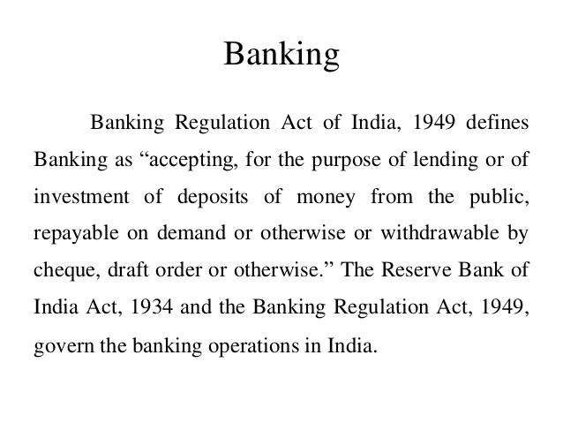

Slide 7
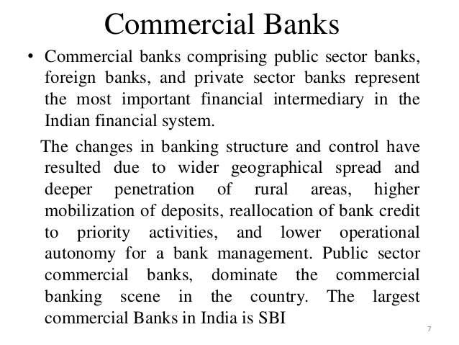

Slide 11
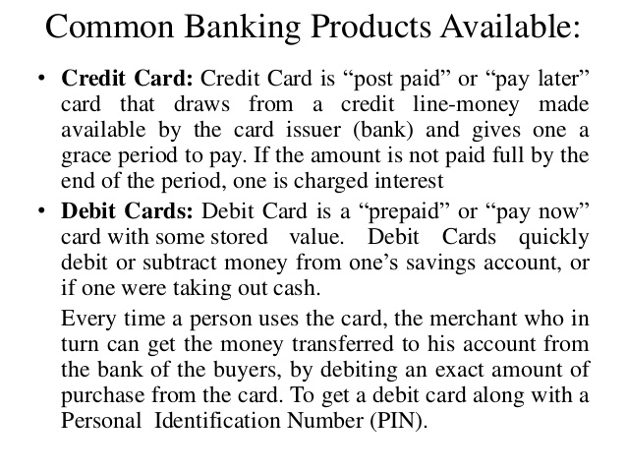

Slide 13
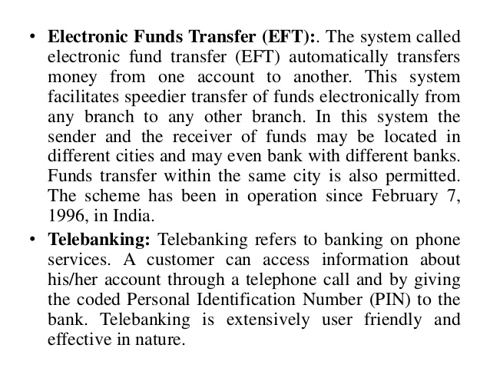

Slide 14
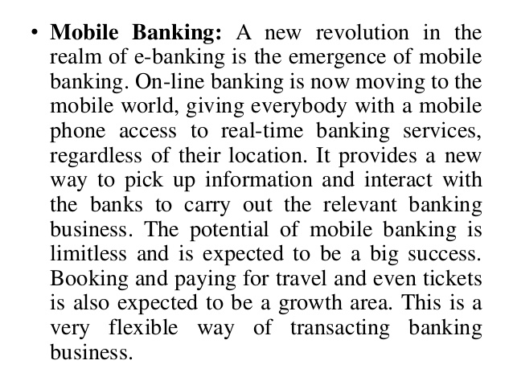

Slide 15
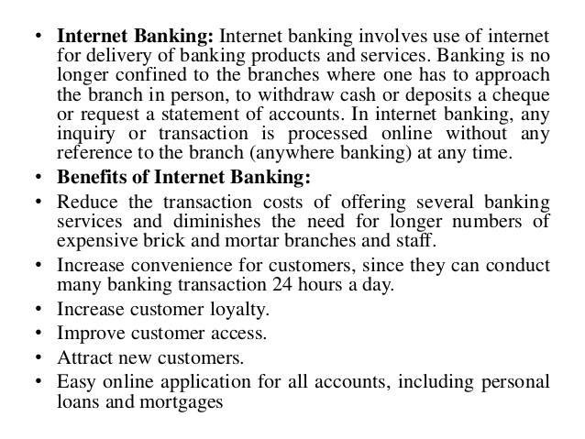

Slide 16
THANK YOU

